Slide 1
SUNDAY WORSHIP
Welcome to Garden English Ministry.
May your hearts be prepared to come into intimate and direct fellowship with God
and His Word through our worship today.
Notes 2 Peter 3:5-6 The heavens existed long ago, and the earth was formed out of water and through water by the word of God, and that by means of these the world that then existed was deluged with water and perished. But by the same word the heavens and earth that now exist are stored up for fire, being kept until the day of judgment and destruction of the ungodly. The flood shows us that man is totally _______________ and worthy of God’s righteous _____________, with the wages of sin being _________. God’s solution is that the shedding of _________ is necessary for our sins to be ______________. Until the final judgement, we see God’s _________ in that we get what we don’t deserve, and God’s ____________ in that we don’t get what we truly deserve. In light of 2 Peter 3:5-6, how are we to live?
Announcements Welcome to all, especially any first time visitors. Please join us for Bible Study immediately after service, followed by fellowship lunch. Today there will be a meeting of the Youth Group PTA after the KM lunch. Teachers are asked to attend. Jan 8 is our next membership class. If anyone would like to schedule make-up sessions for either of the first two sessions, please contact Pastor Syd
Presider: Deacon Paul Cho
Sunday, January 3, 2016 Speaker: Pastor Syd Seiler
Call To Worship Praise Team
Entering the presence of Almighty God
Praise & Worship Congregation
Proclaiming His greatness, our sin, His mercy, our pardon, and our thanks
Responsive Reading Congregation
Corporately proclaiming His Word
The Apostles’ Creed Congregation
Proclaiming the key elements of our faith
Offering & Prayer Congregation
A Prayer that He would accept our thanks
Announcements Deacon Paul Cho
Sharing in the ministry and events of our church
Representative Prayer Congregation
Coming in prayer for the whole body of the church
Scripture Reading Genesis 8:17-9:17 Pastor Syd Seiler
A proclamation of the Word of God
Sermon A New Start Pastor Syd Seiler
Instruction in God’s will for us
Dedication Prayer Pastor Syd Seiler
Prayer for the power to live according to God’s will as we depart.
The Lord’s Prayer Congregation
A prayer as we go out into the world, renewed by the grace of Word and Spirit.
Worship Servants | Today | Next Week
Representative Prayer | Grace Jee | Syd Seiler
Offering Prayer, Ushers | Peter Yoo / Jennifer Yim | Grace Lim / Timothy Han
Praise Team | Joe Jung, David Lim, Shane Seiler, David Song, Arnold Park, Peter Yoo
Notes:
KJHJPOIJ

Slide 2
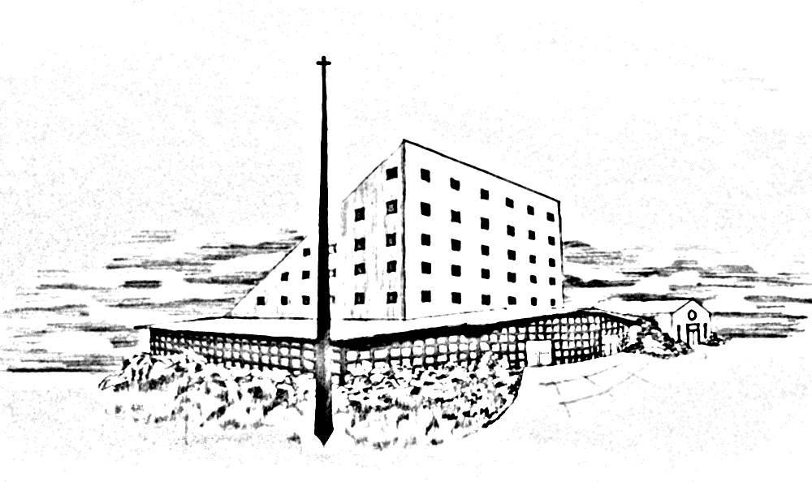
BIBLE STUDY TEACHERS
Garden Presbyterian Church
E.M. Adults & College
Pastor Sydney Seiler
Youth Ministry
Pastor John Jee
9-12th grade
Min Kim, Dee Kim, Arnold Park
6-8th grade
Grace Park, Peter Yoo
4-5th grade
Deacon Pat Han
2-3rd grade
Deacon Joe Jung
(funkyjoe7@hotmail.com)
1st-2nd grade
Deaconess Hyue Young Park
(orthocares@gmail.com)
Kindergarten
Lizzy Cho, Grace Lim
Friday Youth Group Bible Study
Pastor John Jee
English Ministry
GOD-CENTERED • BIBLE-CENTERED • CHURCH-CENTERED
WORSHIP/LOCATION/MEETING TIMES
ENGLISH MINISTRY (E.M.)
Worship……..............................Main Sanctuary…….……...…Sunday 10:00 a.m.
Adult/College Bible Study…New Sanctuary Classroom 1....Sunday 11:15 a.m.
Daniel Group (E.M. Couples)
Bible Study ………………………………………….… 2nd & 4th Sunday 5:00a.m.
(Email Deacon Brian So: bhso83@gmail.com)
Young Adult & College
Bible Study…………….New Sanctuary Classroom 1………..Sunday 11:15 a.m.
Friday Bible Study.……….…..Fellowship Hall.….….…………Friday 7:30 p.m.
Youth Group Ministry (6th-12th grade)
Bible Study …………New Sanctuary Hall Classrooms……. Sunday 11:15 a.m.
Friday Bible Study...……….…Fellowship Hall..….……………Friday 8:00 p.m.
Children’s Ministry (Pre K – 5th grade)
Worship ………..…………..…Main Sanctuary……….…..…. Sunday 11:00 a.m.
Bible Study…….……New Sanctuary Hall Classrooms….….Sunday 12:15 p.m.
KOREAN MINISTRY (K.M.)
1st Worship……………….….…New Sanctuary...............…...... Sunday 8:15 a.m.
2nd (Main) Worship…….….…..New Sanctuary.…………..….Sunday 11:15 a.m.
Wednesday Night…….….…....New Sanctuary......…........Wednesday 8:00 p.m.
Early Morning Prayer..………..New Sanctuary.......................Tue – Sat 5:45 a.m.
Korean Language School..…New Fellowship Hall.................Sunday 10:15 a.m.
“Do it all for the glory of God”
1 Corinthians 10:31
Our Five Foundational Goals and Principles
Worship that is God-centered and God-glorifying.
Scripture alone as the authority for truth and faith.
Edification and equipping of all members for service in building the Church.
Evangelism and missions as the responsibility of all believers.
Fellowship and community based on God’s love.
Senior Pastor & Korean Ministry Pastor
Rev. Nathan Tae Hahn nthahn@gmail.com
English Ministry Pastor & EM/ Adult/College
Pastor Sydney Seiler sydshi@hotmail.com
English Ministry Youth Pastor
Pastor John Jee johnjee@gmail.com
Sunday, January 3, 2016

