Slide 1
SUNDAY WORSHIP
Welcome to Garden English Ministry.
May your hearts be prepared to come into intimate and direct fellowship with God
and His Word through our worship today.
Notes
Announcements Welcome to all, especially any first time visitors. Please join us for Bible Study immediately after service, followed by fellowship lunch. Today we will have our membership class during lunch. All are invited (even if you were there Friday night) to continue our discussion on worship. Today, FYI, the KM is holding its general assembly, where the budget will be discussed, and a vote for officers (both elders and deacons) will be held.
Presider: Deacon Paul Cho
Sunday, January 10, 2016 Speaker: Pastor John Jee
Call To Worship Praise Team
Entering the presence of Almighty God
Praise & Worship Congregation
Proclaiming His greatness, our sin, His mercy, our pardon, and our thanks
Responsive Reading Congregation
Corporately proclaiming His Word
The Apostles’ Creed Congregation
Proclaiming the key elements of our faith
Offering & Prayer Congregation
A Prayer that He would accept our thanks
Announcements Deacon Paul Cho
Sharing in the ministry and events of our church
Representative Prayer Congregation
Coming in prayer for the whole body of the church
Scripture Reading Genesis 39 Pastor John Jee
A proclamation of the Word of God
Sermon Resisting Temptation Pastor John Jee
Instruction in God’s will for us
Dedication Prayer Pastor John Jee
Prayer for the power to live according to God’s will as we depart.
The Lord’s Prayer Congregation
A prayer as we go out into the world, renewed by the grace of Word and Spirit.
Worship Servants | Today | Next Week
Representative Prayer | Syd Seiler | David Song
Offering Prayer, Ushers | Grace Lim / Timothy Han | Min Kim / Glen Lee
Praise Team | Joe Jung, David Lim, Shane Seiler, David Song, Arnold Park, Peter Yoo
Notes:
KJHJPOIJ

Slide 2
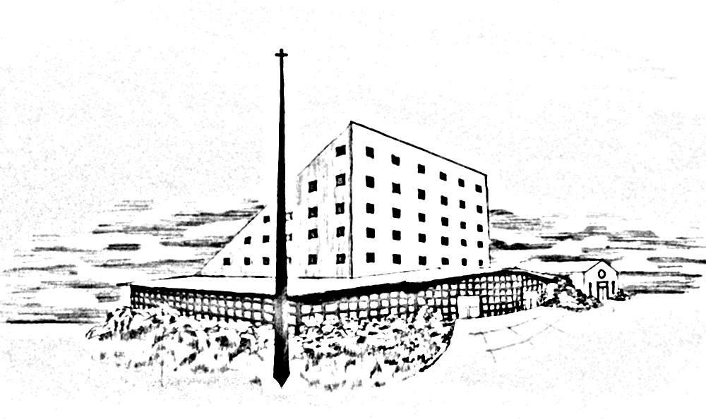
BIBLE STUDY TEACHERS
Garden Presbyterian Church
E.M. Adults & College
Pastor Sydney Seiler
Youth Ministry
Pastor John Jee
9-12th grade
Min Kim, Dee Kim, Arnold Park
6-8th grade
Grace Park, Peter Yoo
4-5th grade
Deacon Pat Han
2-3rd grade
Deacon Joe Jung
(funkyjoe7@hotmail.com)
1st-2nd grade
Deaconess Hyue Young Park
(orthocares@gmail.com)
Kindergarten
Lizzy Cho, Grace Lim
Friday Youth Group Bible Study
Pastor John Jee
English Ministry
GOD-CENTERED • BIBLE-CENTERED • CHURCH-CENTERED
WORSHIP/LOCATION/MEETING TIMES
ENGLISH MINISTRY (E.M.)
Worship……..............................EM Sanctuary……...……...…Sunday 10:00 a.m.
Adult/College Bible Study…New Sanctuary Classroom 1....Sunday 11:15 a.m.
Daniel Group (E.M. Couples)
Bible Study …………………………………………… 2nd & 4th Sunday 5:00p.m.
(Email Deacon Brian So: bhso83@gmail.com)
Young Adult & College
Bible Study…………….New Sanctuary Classroom 1………..Sunday 11:15 a.m.
Friday Bible Study.……….…..Fellowship Hall.….….…………Friday 7:30 p.m.
Youth Group Ministry (6th-12th grade)
Bible Study …………New Sanctuary Hall Classrooms……. Sunday 11:15 a.m.
Friday Bible Study...……….…Fellowship Hall..….……………Friday 8:00 p.m.
Children’s Ministry (Pre K – 5th grade)
Worship ………..…………..…Main Sanctuary……….…..…. Sunday 11:00 a.m.
Bible Study…….……New Sanctuary Hall Classrooms….….Sunday 12:15 p.m.
KOREAN MINISTRY (K.M.)
1st Worship……………….….…New Sanctuary...............…...... Sunday 8:15 a.m.
2nd (Main) Worship…….….…..New Sanctuary.…………..….Sunday 11:15 a.m.
Wednesday Night…….….…....New Sanctuary......…........Wednesday 8:00 p.m.
Early Morning Prayer..………..New Sanctuary.......................Tue – Sat 5:45 a.m.
Korean Language School..…New Fellowship Hall.................Sunday 10:15 a.m.
“Do it all for the glory of God”
1 Corinthians 10:31
Our Five Foundational Goals and Principles
Worship that is God-centered and God-glorifying.
Scripture alone as the authority for truth and faith.
Edification and equipping of all members for service in building the Church.
Evangelism and missions as the responsibility of all believers.
Fellowship and community based on God’s love.
Senior Pastor & Korean Ministry Pastor
Rev. Nathan Tae Hahn nthahn@gmail.com
English Ministry Pastor & EM/ Adult/College
Pastor Sydney Seiler sydshi@hotmail.com
English Ministry Youth Pastor
Pastor John Jee johnjee@gmail.com
Sunday, January 10, 2016

